Slide 1
Tolland Substance Use and Mental Health Data
Data Compiled from: US Census, Connecticut Data Collaborative, Tolland’s 2021 Substance Use and Risk Behaviors Assessment, Youth Voices Count Data, CT Department of Emergency Services and Public Protection, CT Department of Public Health, the Connecticut Crash Data Repository, and the National Survey on Drug Use and Health

Slide 2
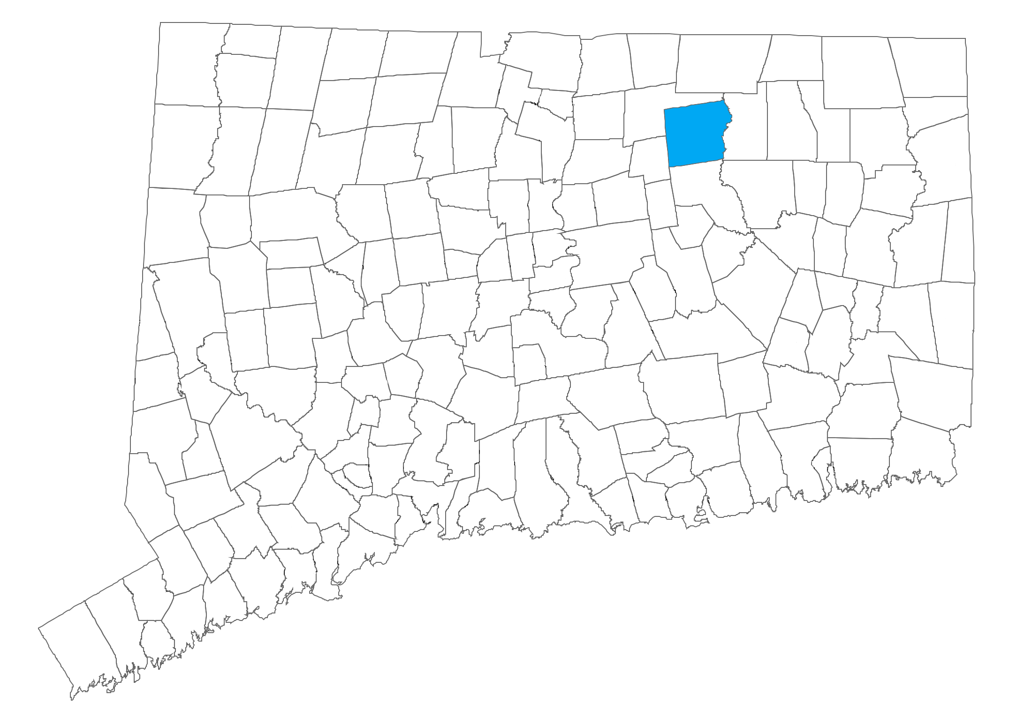
Population: 14,713
Tolland
 | Tolland | Connecticut
Number of Households | 5,252 | 1,370,746
Median Age | 43.4 | 41.0
Median Household Income | $118,194 | $78,444
Poverty Rate | 3% | 10%
Sources: 2020 Census, 2019 American Community Survey 5-year estimates, CT Data Town Profiles 2021

Slide 3
Youth Substance Use

Slide 4
In 2021, the Substance Use and Risk Behaviors Assessment was administered to Tolland students in grades 8-12, 822 students responded.
Source: 2021 Substance Use and Risk Behaviors Assessment
Notes:
Biological sex: 50.3% Female, 49.7% Male

Slide 5
Lifetime Substance Use and Gambling
(Grades 8-12)
*Figure reflects heroin with a needle. Heroin without a needle = 0.9%
Source: 2021 Substance Use and Risk Behaviors Assessment
Notes:
Crack asked separately from cocaine (crack=chunk or rock form), lifetime 1.17%

Slide 6
Past Month Use of Substances and Gambling (Grades 8-12)
Note: SUBRA did not directly ask 30 day use of alcohol or vape
*Figure reflects heroin with a needle. Heroin without a needle = 0.5%
Source: 2021 Substance Use and Risk Behaviors Assessment
Notes:
Crack asked separately from cocaine, 0.9% for PM use

Slide 7
Other Substance Use: Lifetime and Past Month (Grades 8-12)
*Note: students were asked if they had taken various prescription drugs “without a doctor telling them to take them” so medical use should not be represented here.
Source: 2021 Substance Use and Risk Behaviors Assessment
Notes:
Definitions from SUBRA:
Other hallucinogens: PCP, mescaline, peyote, shrooms, psilocybin
Amphetamines or “other prescription stimulants”
Sedatives, including barbiturates- Ambien, Lunesta, sonata
Tranquilizers: Librium, valium, Xanax
Narcotics: other than heroin. Methadone, opium, morphine, codeine, Demerol, Vicodin, oxycontin, Percocet
Steroids: anabolic, without doctor rx
Inhalants: glue, aerosol spray cans, other gasses or sprays for the purpose of getting high
Rohypnol: rophies, roofies

Slide 8
Alcohol Use (Grades 8-12)
22.6% of youth reported ever using alcohol.
The chart below shows on how many occasions, among those who had used.
Source: 2021 Substance Use and Risk Behaviors Assessment
Notes:
“On how many occasions have you ever had any alcoholic beverages to drink… more than just a few sips… in your lifetime?

Slide 9
Alcohol Use: Occasions of being drunk or intoxicated
22.6% of youth reported ever using alcohol.
The chart below shows on how many occasions, among those who had used, they reported being drunk or intoxicated.
Source: 2021 Substance Use and Risk Behaviors Assessment
Notes:
“On how many occasion, if any, have you been drunk or intoxicated from drinking alcoholic beverages in your lifetime?”
Note, none was not a choice.

Slide 10
Past Two Weeks: Binge Drinking (5 or more drinks)
22.6% of youth reported ever using alcohol.
The chart below shows on how many occasions, among those who had used, they reported being drunk or intoxicated.
Among those who have ever consumed alcohol, 31.3% reported binge drinking in the past 2 weeks.
This is about 7.2% youth grades 8-12.
Source: 2021 Substance Use and Risk Behaviors Assessment
Notes:
“Think back over the past two weeks. How many times have you had 5 or more drinks in a row?”

Slide 11
Substances Used in Vape
(Grades 8-12)
Source: 2021 Substance Use and Risk Behaviors Assessment

Slide 12
Sources of Substances: Where substances are acquired by those who accessed
(Grades 8-12)
Source: 2021 Substance Use and Risk Behaviors Assessment
Notes:
Among those who accessed

Slide 13
Ease of Access, Grades 8-12
% reporting fairly difficult, very difficult, or probably impossible
*10.3% of students reported someone had made an offer at school to sell or give them one of these substances.
Source: 2021 Substance Use and Risk Behaviors Assessment
Notes:
*note for less frequently used substance, high percentage of students responded “can’t say”- likely making % reporting “difficult” lower than without that choice

Slide 14
Past Two Weeks: Passenger of a Driver Under the Influence
Source: 2021 Substance Use and Risk Behaviors Assessment
Notes:
During the last two weeks, how many times, if any, have you been a passenger in a car when the driver had been drinking alcoholic beverages?

Slide 15
Perception of Risk (Grades 8-12)
Source: 2021 Substance Use and Risk Behaviors Assessment

Slide 16
Youth Emotional Health Indicators
The following youth emotional health indicators come from a comparison community in Connecticut in the same District Reference Group as Tolland (DRG C). This community surveyed in spring of 2022.
Note: DRG groupings come from the state Department of Education, and are determined based on socioeconomic status (median family income, parental education, parental occupation), need (% of children in single parent households, % of children eligible for free/reduced meals, % of children whose families speak another language at home), and enrollment size.

Slide 17
Past Year Anxiety- Comparison Community, DRG C
Emotional Health
About 32% of youth report “almost always” or “always” feeling anxious or nervous in the past year
Source: 2022 Youth Voices Count- Comparison Connecticut Town- DRG C
Notes:
Spring 2022 Comparison Community Data

Slide 18
Emotional Health
Sources of Stress - Comparison Community, DRG C
Source: 2022 Youth Voices Count- Comparison Connecticut Town- DRG C

Slide 19
Emotional Health
Other Emotional Health Indicators
% Responding “Yes” – Comparison Community, DRG C
Source: 2022 Youth Voices Count- Comparison Connecticut Town- DRG C

Slide 20
Emotional Health
Comfort Seeking Help by Source
Comparison Community, DRG C
Source: 2022 Youth Voices Count- Comparison Connecticut Town- DRG C

Slide 21
Emotional Health
Perception of Having a Trusted Adult and Feelings of Safety
Comparison Community- DRG C
Source: 2022 Youth Voices Count- Comparison Connecticut Town- DRG C

Slide 22
Arrest and Crash Data (All Ages)

Slide 23
Alcohol and Drug-Related Arrests
2020 Drug-Related Arrests:
Juvenile Arrests
3 among individuals <18 years old
1 sale/manufacturing
2 possession
All related to marijuana
Adult Arrests
11 arrests among adults 18+
3 sale/manufacturing (2 opioid, 1 other)
8 possession (5 opioid, 2 marijuana, 1 other)
Source: Connecticut State Department of Emergency Services and Public Protection: Uniform Crime Report- CT State Police- Tolland
Notes:
Subject to reporting, changes in priorities and enforcement

Slide 24
Alcohol & Drug Related Crashes
 | 2015 | 2016 | 2017 | 2018 | 2019 | 2020 | 2021
Under the Influence | 12 | 9 | 14 | 11 | 11 | 13 | 17
Total | 293 | 294 | 285 | 257 | 269 | 169 | 229
% | 4.10 | 3.06 | 4.91 | 4.28 | 4.09 | 7.69 | 7.42
Source: Connecticut Crash Data Repository
Notes:
*By Location of Accident (not necessarily residence)
(note, 84 runs thru, other routes ie 195, 74, 30)

Slide 25
Unintentional Overdose Data

Slide 26
Unintentional Fatal Overdoses
*2022 through December 18
Note: Substances are not exclusive of other substances
Source: Connecticut State Unintentional Drug Overdose Reporting System (SUDORS), reported by Department of Public Health
Notes:
Residents of Tolland
Race/Ethnicity: 100% white NH
Fentanyl includes analogs

Slide 27
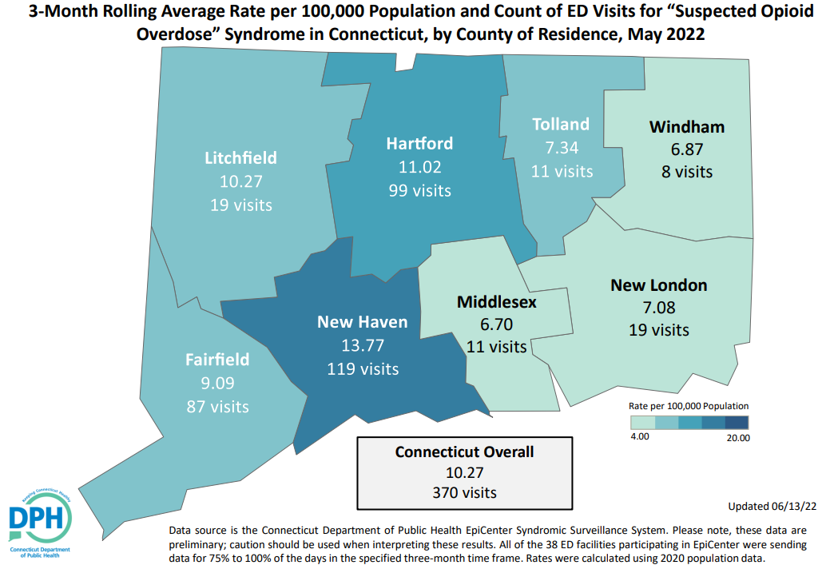
Suspected Opioid Overdose
Source: Connecticut Department of Public Health

Slide 28
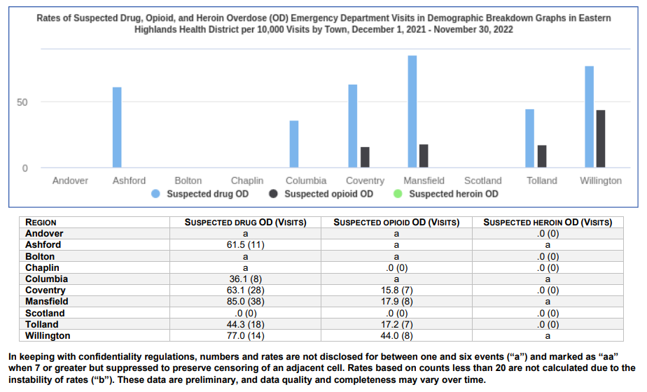
Suspected Opioid Overdose
Rates of Suspected Drug, Opioid, and Heroin Overdose (OD) Emergency Department Visits
Eastern Highlands Health District per 10,000 Visits by Town, December 1, 2021-November 30, 2022
Source: Connecticut Department of Public Health, Office of Injury and Violence Prevention – December 7, 2022

Slide 29
Adult Substance Use Data

Slide 30
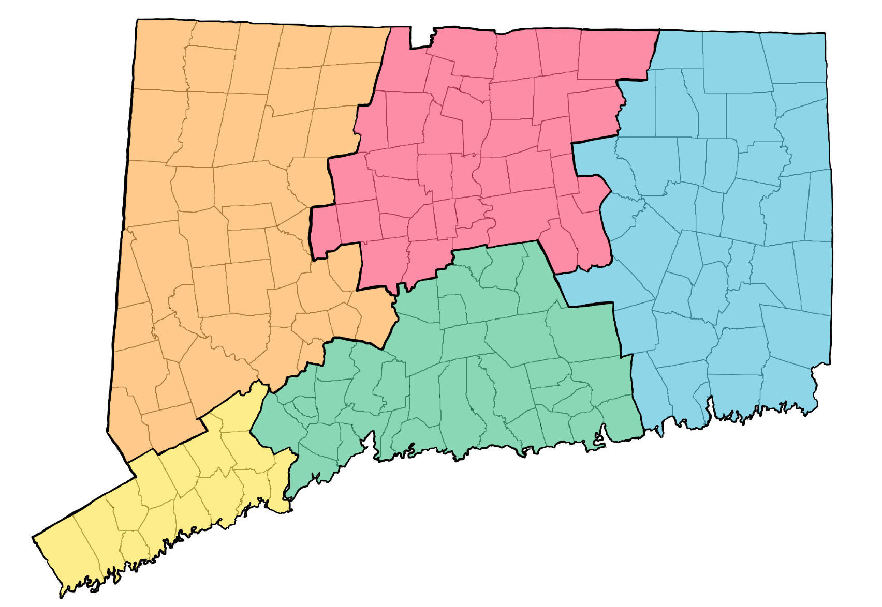
National Survey on Drug Use and Health (NSDUH) provides substate estimates at the regional level
Region 4
Region 5
Region 3
Region 2
Region 1
Notes:
2018-2020 NSDUH substate estimates

Slide 31
Substance Use
*
*
*
*Substate estimate for 18-25 unavailable at substate level due to low precision, CT shown here instead.
Source: National Survey on Drug Use and Health- Substate Estimates
Notes:
Binge Alcohol Use is defined as drinking five or more drinks (for males) or four or more drinks (for females) on the same occasion (i.e., at the same time or within a couple of hours of each other) on at least 1 day in the past 30 days.

Slide 32
Substance Use
*Definition change for binge drinking in 2015
Source: National Survey on Drug Use and Health- Substate Estimates
Notes:
Binge Alcohol Use WAS defined as drinking five or more drinks on the same occasion (i.e., at the same time or within a couple of hours of each other) on at least 1 day in the past 30 days, but changed in 2015 to five or more drinks for males or four or more drinks for females, thus, NSDUH did not include binge estimates for the 2014-2016 time period because of the item change.

Slide 33
Substance Use
*
*
*Low precision for heroin use in general, CT value reflected here for 26+.
Source: National Survey on Drug Use and Health- Substate Estimates
Notes:
NOTE: Substate estimates for youths aged 12 to 17, young adults aged 18 to 25, and adults aged 18 or older are not available for past year heroin use in 2018-2020. Past year heroin use was extremely rare among youths aged 12 to 17 in 2018-2020; hence, substate estimates could not be produced for youths aged 12 to 17. Thus, data for the 12 to 17 and 18 to 25 age groups were combined to produce an estimate of past year heroin use among people aged 12 to 25. In this table, past year heroin use estimates are available for people aged 12 to 25 and 26 or older.
Notable decline in pain reliever misuse compared to 2016-2018 estimates.

Slide 34
Substance Use
Source: National Survey on Drug Use and Health- Substate Estimates
Notes:
Alcohol Use Disorder is defined as meeting criteria for alcohol dependence or abuse. Dependence or abuse is based on definitions found in the 4th edition of the Diagnostic and Statistical Manual of Mental Disorders (DSM-IV).
Substance Use Disorder is defined as meeting criteria for illicit drug or alcohol dependence or abuse. Dependence or abuse is based on definitions found in the 4th edition of the Diagnostic and Statistical Manual of Mental Disorders (DSM-IV).
Needing But Not Receiving Substance Use Treatment refers to respondents who are classified as needing illicit drug or alcohol treatment, but who did not receive illicit drug or alcohol treatment at a specialty facility

Slide 35
Adult Mental Health Data

Slide 36
Mental Health
Source: National Survey on Drug Use and Health- Substate Estimates
Notes:
Major depressive episode (MDE) is defined as in the 5th edition of the Diagnostic and Statistical Manual of Mental Disorders (DSM-5), which specifies a period of at least 2 weeks when an individual experienced a depressed mood or loss of interest or pleasure in daily activities and had a majority of specified depression symptoms.

Slide 37
Mental Health
1.4% in Region 4 reported making a suicide plan, and 0.5% reported attempting suicide in the past year.
Source: National Survey on Drug Use and Health- Substate Estimates

Slide 38
Mental Health
Source: National Survey on Drug Use and Health- Substate Estimates
Notes:
Mental Health Services are defined as having received inpatient treatment/counseling or outpatient treatment/counseling or having used prescription medication for problems with emotions, nerves, or mental health. Respondents were not to include treatment for drug or alcohol use.

